Slide 1
TB Screening and Differentiated Service Delivery: State of the Art
Andrea A. Howard, MD, MS
Clinical & Training Unit Director, ICAP at Columbia University
22 July 2019

Slide 2
TB Screening is Essential for People Living with HIV
TB is common among people living with HIV
TB can be fatal
TB is treatable
TB screening improves survival
TB screening prevents transmission
TB screening identifies individuals eligible for TB preventive treatment

Slide 3
WHO Algorithm for Screening Adults and Adolescents Living with HIV for TB
WHO. Latent tuberculosis infection: updated guidelines for programmatic management, 2018

Slide 4
Performance of TB Symptom Screening Tool
Systematic review and meta-analysis of 18 studies
 | Sensitivity | Specificity
PLHIV not receiving ART (n=8664)
Cough, fever, weight loss, or night sweats | 89.4% (95% CI 83.0, 93.5) | 28.1% (95% CI 18.6, 40.1)
PLHIV receiving ART (n=4640)
Cough, fever, weight loss, or night sweats | 51.0% (95% CI 28.4-73.2) | 70.7% (95% CI 47.8%, 86.4%)
Cough, fever, weight loss, or night sweats OR abnormal CXR findings (2 studies, n=646) | 84.6% (95% CI 69.7, 92.9) | 29.8% (95% CI 26.3, 33.6)
Hamada et al, Lancet HIV 2018; 5:e515-23

Slide 5
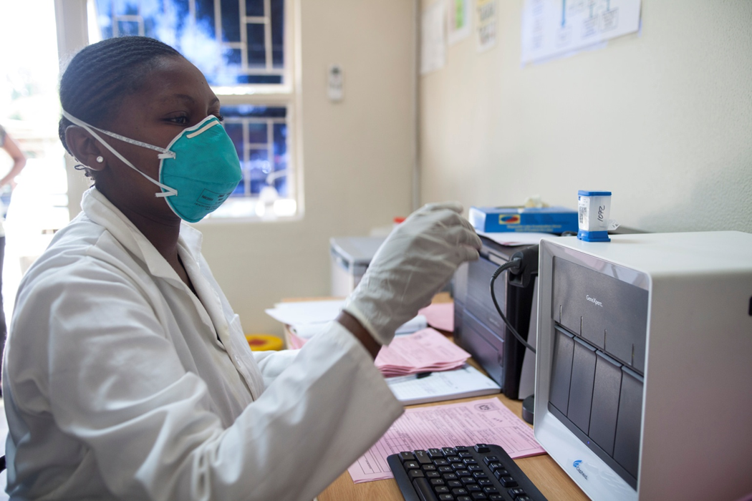
Xpert MTB/RIF Ultra is the Initial Diagnostic Test of Choice for PLHIV with Presumptive TB
Automated, integrated cartridge-based molecular assay
Detects TB and rifampicin resistance in under two hours
8-country study of Xpert Ultra vs. Xpert in adults with PTB¹
↑ sensitivity, ↓ specificity (detects dead bacilli)
Minimal biosafety and training requirements
Requires uninterrupted power supply, max temperature 30° C
Battery-operated Xpert Omni under evaluation
 | Tuberculosis Detection |  | Rifampicin Resistance
 | Sensitivity (HIV+) n=155 | Specificity (overall) n=977 | Sensitivity n=175 | Specificity n=376
Xpert | 77% (95% CI 68, 84) | 98% (95% CI 97, 99) | 95% (95% CI 91, 98) | 98% (95% CI 96, 99)
Xpert Ultra | 90% (95% CI 83, 95) | 96% (95% CI 94, 97) | 95% (95% CI 91, 98) | 98% (95% CI 97, 99)
¹Dorman et al, Lancet Inf Dis 2018;18:76-84

Slide 6
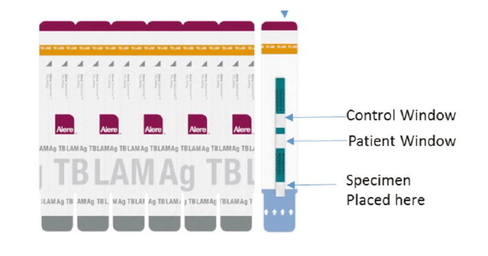
LF-LAM Can be Used as Additional Diagnostic Test for PLHIV with TB Symptoms and Advanced Disease
Detects lipoarabinomannan, mycobacterial cell wall antigen, indicating active PTB or EPTB
60 µl urine applied to test strip, incubates at room temperature for 25 minutes, inspected by eye
Point-of-care, inexpensive, easy to perform, easy to collect sample, minimal biosafety requirements
Sensitivity 56%, specificity 90% (CD4 count <100)¹; does not test drug resistance
Recommended by WHO to assist in diagnosis of TB in PLHIV with TB symptoms and CD4 count <100 or who are seriously ill
Use in hospitalized PLHIV with TB symptoms reduced mortality²
FUJIFILM LAM- higher diagnostic accuracy than Alere Determine TB LAM Ag in bio-banked samples³; prospective studies ongoing
¹ WHO; The use of LF-LAM for the diagnosis and screening of active TB in people living with HIV; 2015; ²Peter, Lancet 2016; 387:1187-97; ³Broger, Lancet Inf Dis 2019; S1473-3099 (19)30001-5

Slide 7
Role of Chest X-ray in TB Screening
CXR at end of diagnostic algorithm, in individuals with negative bacteriologic testing
Low specificity, high interobserver variation
Poor access to high-quality radiography equipment and expert interpretation
Chest radiography may be offered to people living with HIV and on ART and preventive treatment given to those with no abnormal radiographic findings.
Conditional recommendation, low-quality evidence
Chest radiography should not be a requirement for initiating preventive treatment.
With increasing availability of digital x-ray, potential for telemedicine, interest in its use in screening or triaging
Challenges: costs, infrastructure requirements, availability of qualified staff
Potential future role for computer-aided detection, mobile CXR
WHO, Chest radiography in tuberculosis detection, 2016

Slide 8
TB Screening in DSD
Less contact with health providers could mean fewer opportunities for TB screening
Optimal frequency of TB screening for PLHIV who are stable on ART not known
TB screening could be performed lay workers in the community
Establish systems to monitor frequency and quality
Ensure linkage to diagnostic services for individuals with positive symptom screen

Slide 9
Summary
TB screening is a gateway to both treatment and prevention, resulting in improved patient outcomes and decreased TB transmission
The symptom screening tool is more sensitive in PLHIV who are ART-naïve, and more specific in PLHIV on ART
Xpert Ultra is the diagnostic test of choice in PLHIV with a positive symptom screen
LF-LAM should be performed for PLHIV with advanced disease
Exciting opportunities on horizon
Don’t let the perfect be the enemy of the good

